Slide 1
TRAINING PROVIDERS TEMPLATE – HOW TO USE THIS SLIDE IS TO BE DELETED ONCE YOUR PRESENTATION IS READY
This template is for your organization:
Add your organization’s logo
Remove anything you don’t want to include
Add or edit content so that it suits your needs
The notes at the bottom of the slide contain some key messages you could say, suggestions for some activities and ideas you can take or leave

Slide 2
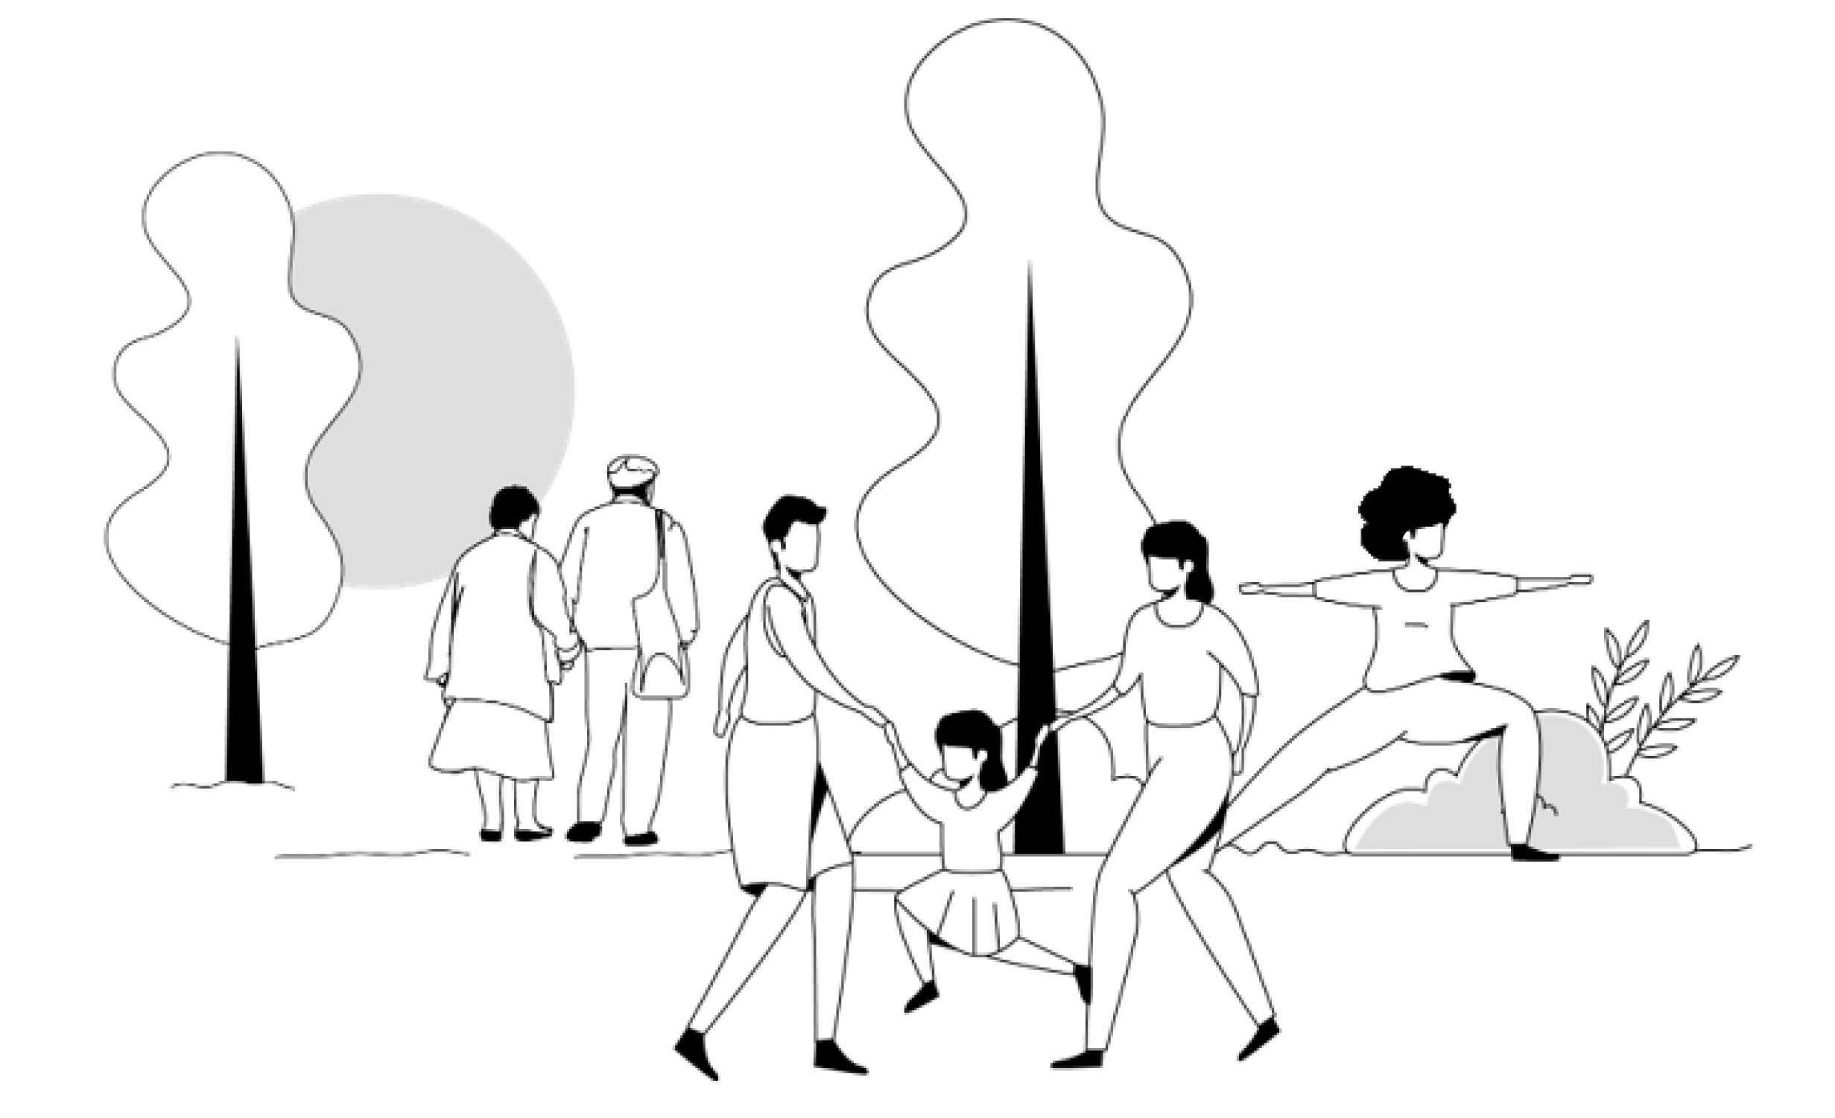

Social Prescribing at [name of your organization]
Duration: 2 min

Slide 3

WHAT IS SOCIAL PRESCRIBING?
Social prescribing is connecting a client to a non-clinical program or service that supports their health and wellbeing.
Notes:
Key messages: Social prescribing can look different for each community depending on resources and supports.

Slide 4
WHAT IS SOCIAL PRESCRIBING?
Or put another way:
An intentional, structured way of connecting people with a range of local, non-clinical services, to address the determinants of health and wellbeing for your clients and community members.
Notes:
Key messages: Social prescribing can look different for each community depending on resources and supports.

Slide 5

WHAT IS SOCIAL PRESCRIBING?
But social prescribing isn’t new!
That’s true!
Social prescribing may be a new name for something we are already doing
Building a more formal social prescribing pathway:
helps make it intentional
helps streamline the process of connecting clients to resources
documents the work
provides data for quality improvement
provides a strong case for increased funding and resources
Notes:
Delete if irrelevant to your situation

Slide 6

WHAT IS SOCIAL PRESCRIBING?
Instead of asking:
We are asking:
What is the matter with you?
What matters to you?

Slide 7

Our Process Map
5 min

Slide 8
OUR SP PROCESS MAP
[Include your SP pathway here or present a copy and guide the providers through it if, highlighting their role]

Slide 9
Benefits of Social Prescribing for the Providers
2 min

Slide 10



THE IMPACT OF SOCIAL PRESCRIBING
The impacts of social prescribing from programs in the UK (2017–2019) demonstrate that from social prescribing, the healthcare system saw a:
14%
40%
20.8%
Decrease in emergency room visits
Decrease in general
physician visits
Reduction in costs to the health system

Slide 11



THE IMPACT OF SOCIAL PRESCRIBING
At the end of the Alliance for Healthier Communities social prescribing research pilot:
29%
36%
41%
More clients scored their mental health as either excellent, very good, or good after participating in SP
More clients scored their sense of community belonging as either excellent, very good or good after participating in SP
Of providers reported observing a decrease in the number of repeat visits among clients who participated in SP

Slide 12


POSITIVE IMPACTS FOR CLIENTS AND PROVIDERS
The ability to offer social prescriptions has decreased my visits. It has alleviated stressors for my clients. I have seen positive turn-arounds in clients’ overall mood. Social prescribing also helps ease the strain on our health system, while giving clients a sense of community and belonging that COVID-19 restraints eroded.
— Terry, Health Provider
Windsor

Slide 13

POSITIVE IMPACTS FOR CLIENTS AND PROVIDERS
For 6 months I resisted asking the questions [about loneliness and wellbeing] to the client, thinking it would take too long. When I finally did it, it took no more than a minute!
— A nurse
A nurse

Slide 14
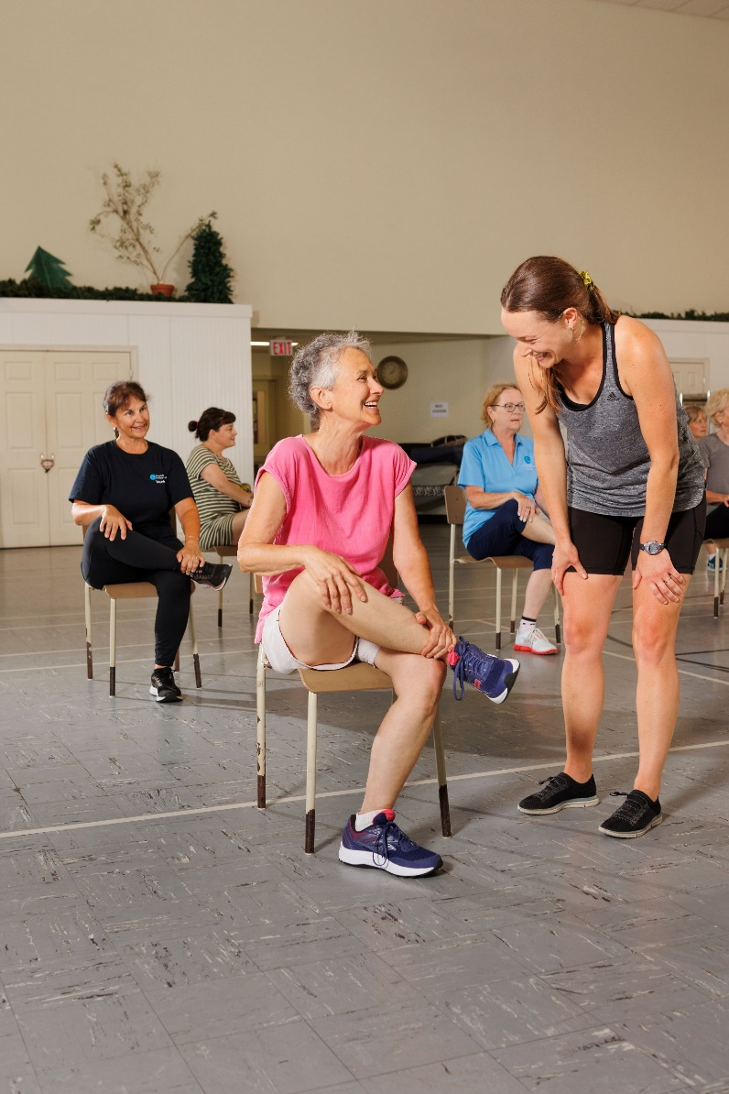
POSITIVE IMPACTS FOR CLIENTS AND PROVIDERS
I appreciated the kindness of people and realizing that there are nice people in this world. It’s just a matter of finding them. Another lady I know, she’s in her eighties, and she lost her husband about a year ago. She is very lonely. That’s why I encouraged her to go to Life After Fifty. Like me, she needed the initial push to go, but I think once she goes, she’ll enjoy it.
— Linda, Links2Wellbeing Project Participant
Seaway Valley CHC

Slide 15
An Example of a Provider-Client Conversation
3 min

Slide 16


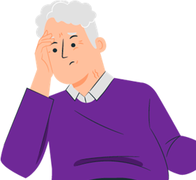
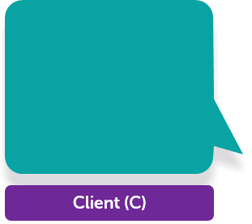
THE MAGIC OF CONNECTION 1/7
P
Hello, and welcome to the XX CHC. My name is Dr. X, and I’m here to talk with you about your health and wellbeing. Can you tell me a little bit about why you’re here today?
Yes, I’m here because I’ve been feeling really stressed lately. I’m having trouble sleeping and concentrating, and it’s starting to affect my work and personal life.
C
Provider (P)
Notes:
Here is an example of how a conversation could go between you and your clients.

Slide 17
THE MAGIC OF CONNECTION 2/7
P
I’m sorry to hear that. We’ll definitely work on addressing those issues, but I also wanted to talk with you about the things that might be behind those feelings and ways to address them. Have you ever heard about a social prescription?
No, I haven’t. What is it?
And how can it help?
C
Provider (P)
Notes:
Here is an example of how a conversation could go between you and your clients.

Slide 18
THE MAGIC OF CONNECTION 3/7
P
A social prescription is when we recommend activities or programs that can help improve your overall health and wellbeing instead of just prescribing medications to take care of the symptoms. These can be things like exercise classes, community events, or support groups. We know that health is not just about medical care, but also about the social and economic factors that affect our lives and the time we spend with others.
Provider (P)
That makes sense. So what kind of social prescription would you recommend for me?
C
Notes:
Here is an example of how a conversation could go between you and your clients.

Slide 19
THE MAGIC OF CONNECTION 4/7
P
Well, based on our conversations so far, and your interest in the outdoors, I think it would be beneficial for you to connect with a local group of people that meet for walking and to enjoy nature, this could also help with your stress and anxiety but more importantly it will connect you with other people in your community. We have a few options that we can recommend, and we’ll make sure to choose one that is accessible and inclusive for you. We want to make sure that you feel comfortable and supported in this group.
Provider (P)
That sounds great. Thank you for suggesting that.
C
Notes:
Here is an example of how a conversation could go between you and your clients.

Slide 20
THE MAGIC OF CONNECTION 5/7
P
Of course. And just to make sure that you would be able to participate fully, we’ll also take into account any social or economic factors that might affect your ability to participate in the group. For example, we’ll make sure that it’s located in a place that is easy for you to get to, and that the cost is affordable for you. We want to make sure that it is something that can easily fit into your life. Are there any other concerns you might have about accessing the support group we recommend? For example, is there a language barrier, or do you have any physical limitations that might make it difficult to attend?
Provider (P)
I don’t have a car, but I can take public transportation.
C
Notes:
Here is an example of how a conversation could go between you and your clients.

Slide 21
THE MAGIC OF CONNECTION 6/7
P
Great, we’ll make sure to recommend a support group that is easily accessible by public transportation. And just to make sure that the cost is not a barrier for you, we have programs that support with costs and the group is free of charge. Is there anything else you want to let me know about your needs or concerns before we move forward with the social prescription?
Provider (P)
No, that’s all. Thank you for asking these questions and for taking the time to help me.
C
Notes:
Here is an example of how a conversation could go between you and your clients.

Slide 22
THE MAGIC OF CONNECTION 7/7
P
Of course, we want to make sure that you have all the possibilities, resources and support you need to live a healthy life. Please let us know if you have any other questions or concerns, and we’ll be happy to help in any way we can.
I really appreciate that. Thank you for taking the time to talk with me today.
C
Provider (P)
Notes:
Here is an example of how a conversation could go between you and your clients.

Slide 23
QUESTIONS TO GUIDE CONVERSATIONS TO SURFACE AS SDOH
How do you spend your time?
Can you tell me a little bit about your current living situation?
Have there been times where you felt lonely or isolated? Can you tell me about it?
When you're going through difficult times, who are some of the people you rely on for support?
Are there any places in your community/neighborhood where you feel like you belong?
Notes:
Acknowledge that health and well-being are complex. Sometimes it takes a team of caring professionals and a community of resources to support your patients’ needs. Introduce and discuss with your patient the idea of social prescribing and its ability to help address the non-medical concerns that may be impacting their health and well-being.
“There are many things that affect our health – I am one supportive resource that can help you address your medical concerns, but there are other people in our community who may also be able to help you with other aspects of your health.”

Slide 24
IN A NUTSHELL
Acknowledge that health and well-being are complex.
Sometimes it takes a team of caring professionals and a community of resources to support your patients’ needs.
Introduce and discuss with your patient the idea of social prescribing and its ability to help address the non-medical concerns that may be impacting their health and well-being.
Notes:
“There are many things that affect our health – I am one supportive resource that can help you address your medical concerns, but there are other people in our community who may also be able to help you with other aspects of your health.”

Slide 25
COMMON QUESTIONS AND CRITIQUES
How can I implement social prescribing when my time with the patient is already so limited?
By asking 1 or 2 extra questions about your patient’s social health or their social determinants of health, you will be saving time later by getting to the heart of what matters to your patients.

Slide 26
COMMON QUESTIONS AND CRITIQUES
It feels overwhelming to start looking at social needs as well as clinical needs.
Start where you are, start small. This might mean asking 1 or 2 additional questions and making sure you have relatively simple referrals handy such as 211, Ontario Caregivers Organization or the Ontario Seniors Active Living centre closest to you.

Slide 27
COMMON QUESTIONS AND CRITIQUES
I am already doing this; I already tell my clients about non-clinical programs in the community.
By implementing a formal social prescribing referral pathway, we can be more systematic about this work. With a clear referral pathway in the EMR we are able to measure the impact of non-clinical referrals. It can also support interdisciplinary and inter-team collaboration.

Slide 28
COMMON QUESTIONS AND CRITIQUES
This might work for a doctor, but it would not work for a nurse practitioner/other clinician.
We have found that social prescribing can be implemented by various regulated health professionals including physicians, nurses, dieticians, nurse practitioners, dentists and others. We have also found that it can work in many different settings including team-based primary care, family health teams, solo doctors’ offices and Indigenous-led primary health care. We have found it can work in large urban settings as well as small rural settings.

Slide 29
Questions?
5 to 10 min

